Slide 1
WELCOME TO OUR PROUD NEW CORGI PARENTS AND FAMILIES!

Slide 2
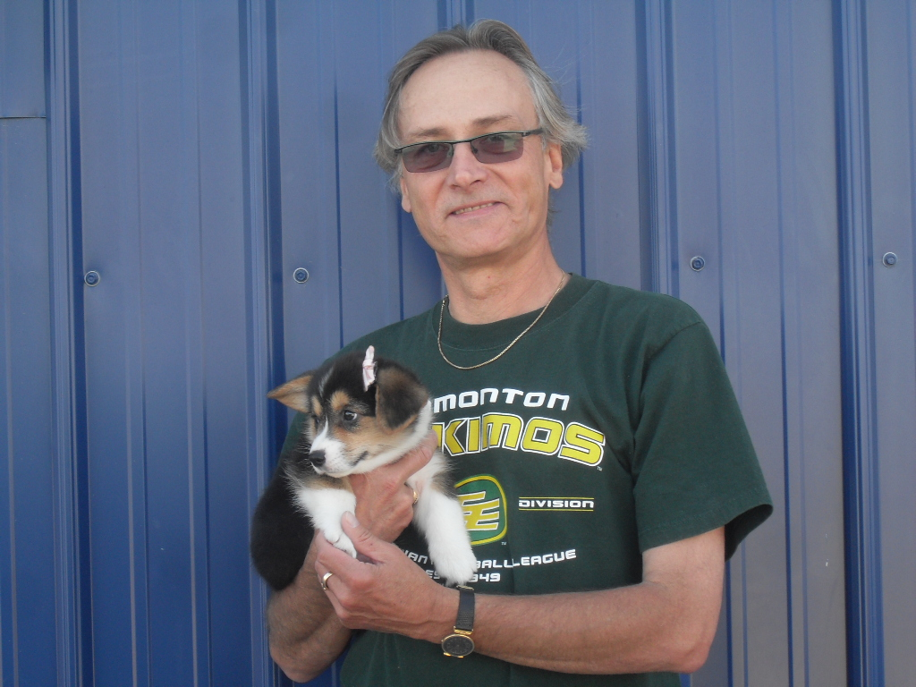
Maggie-Mae ( Bashful) is now with her daddy, Lori and resides in Pearceland Saskatchewan.

Slide 3
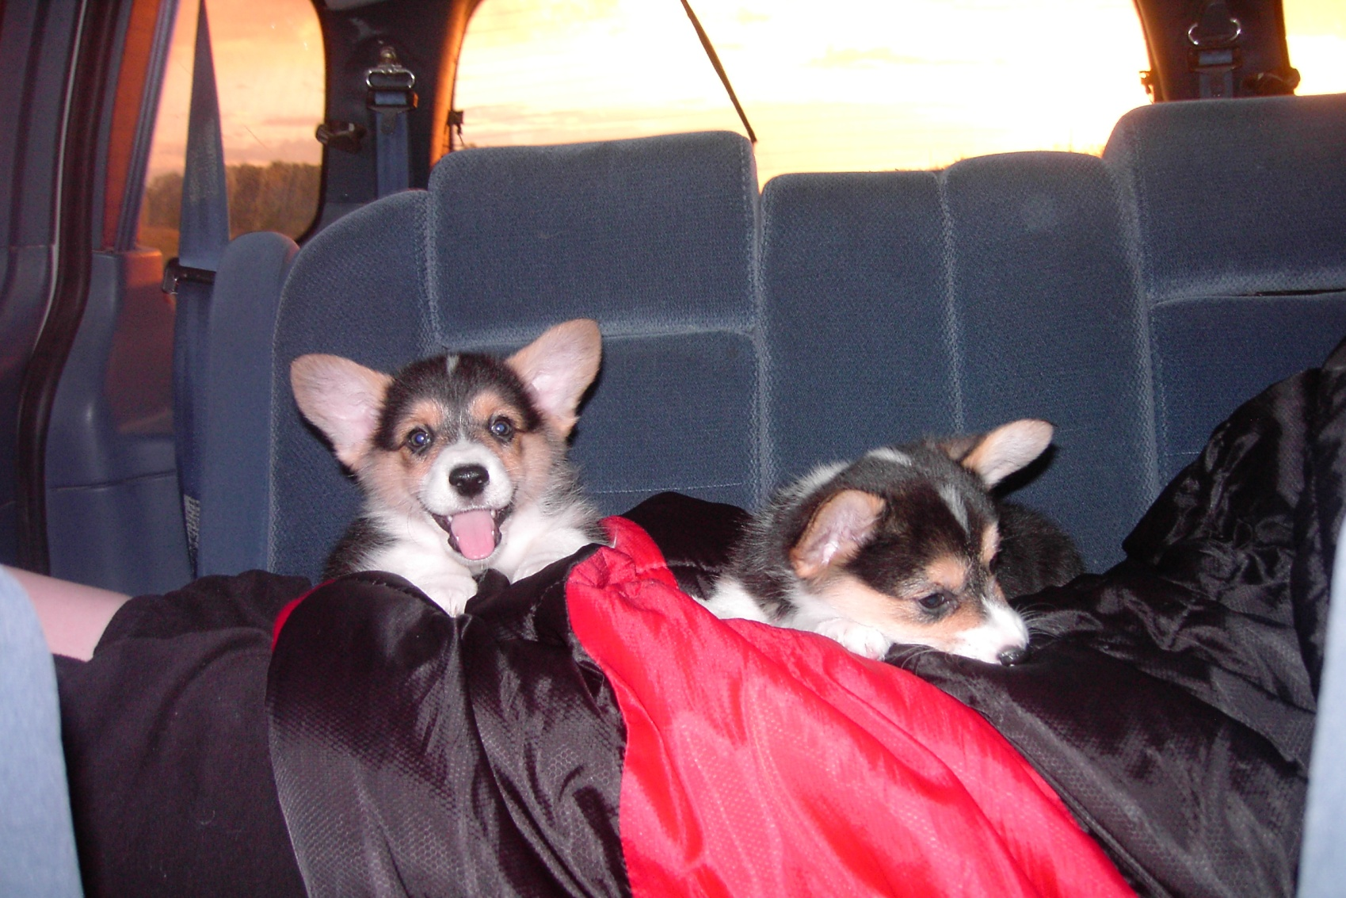
On the way to meet our new parents. Indy and Frankie

Slide 4
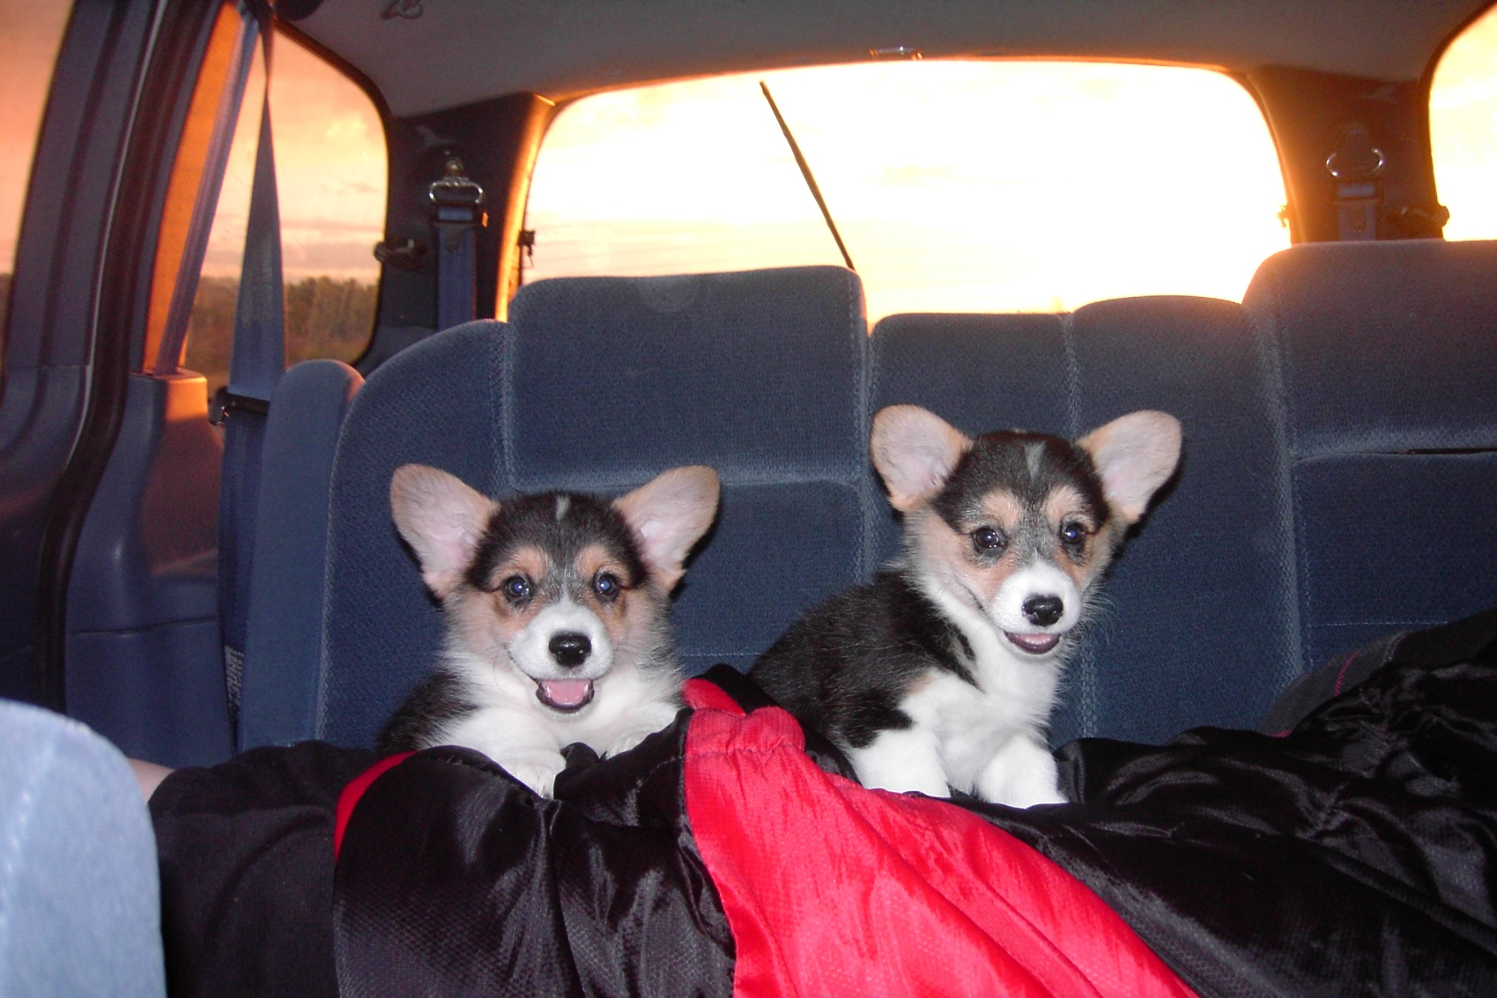
Indy and Frankie so awake in the early am!

Slide 5
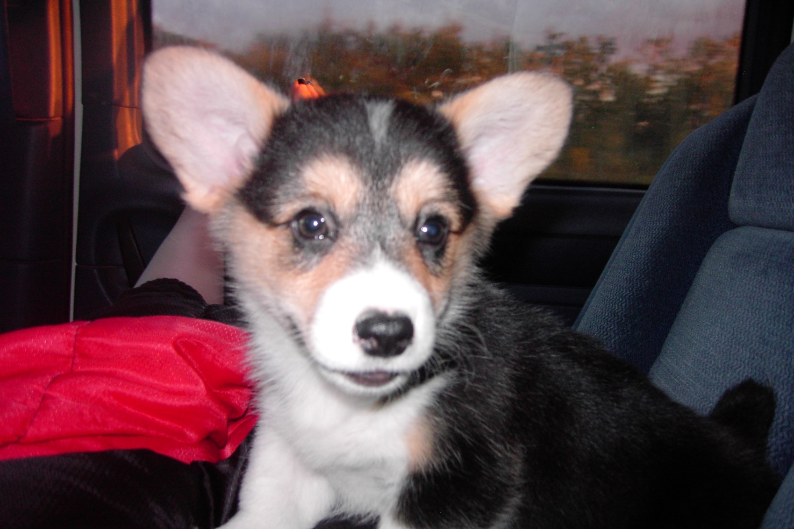
Are we there yet?

Slide 6
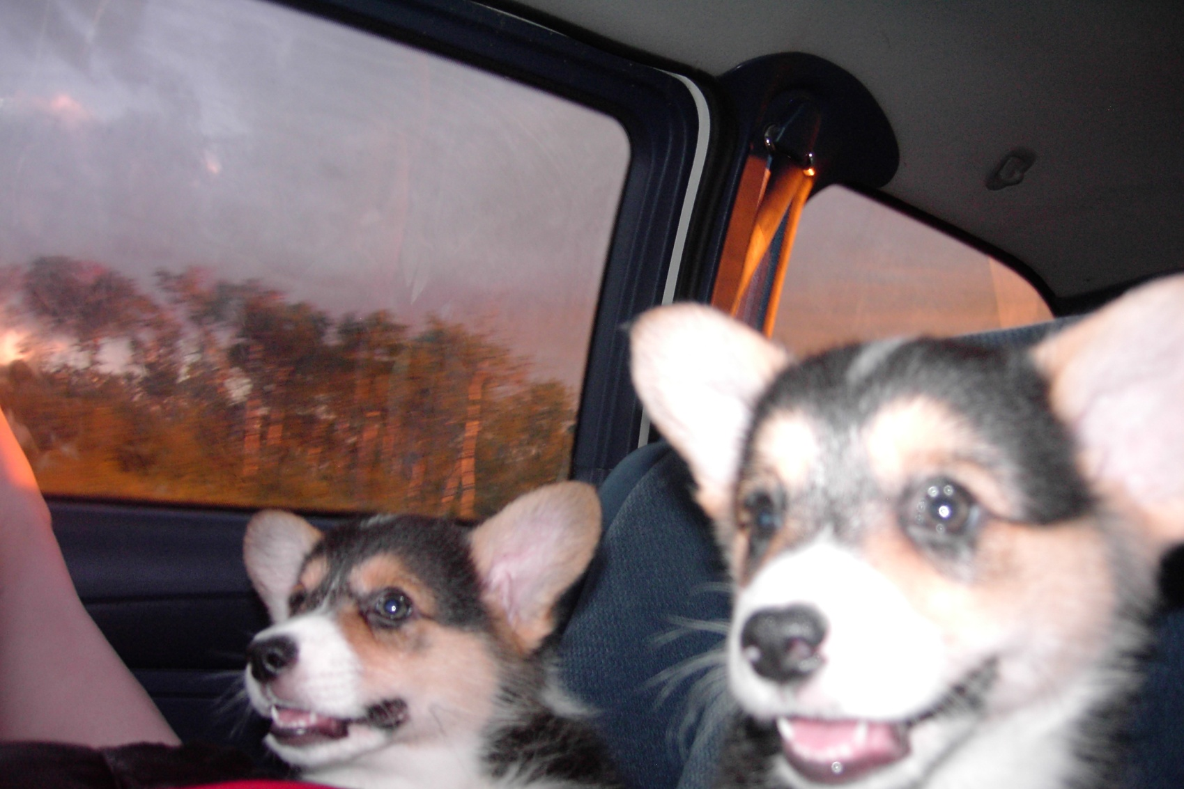
How about now?

Slide 7
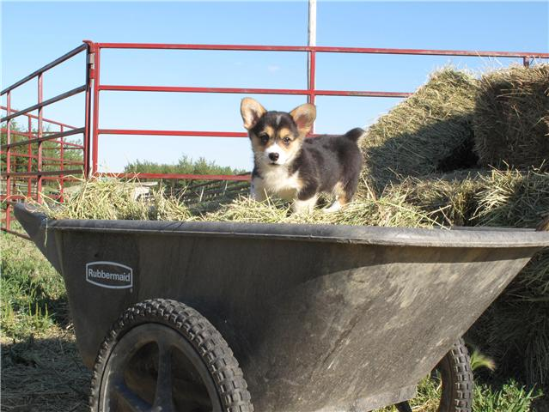
Indy (Sleepy) now resides with Diane and family in Grand Prairie Alberta

Slide 8
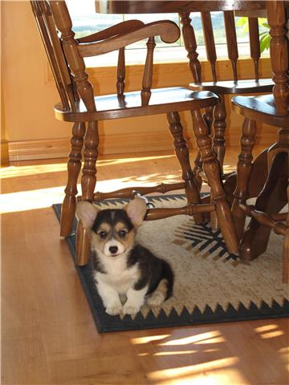
Indy loves her new home!

Slide 9
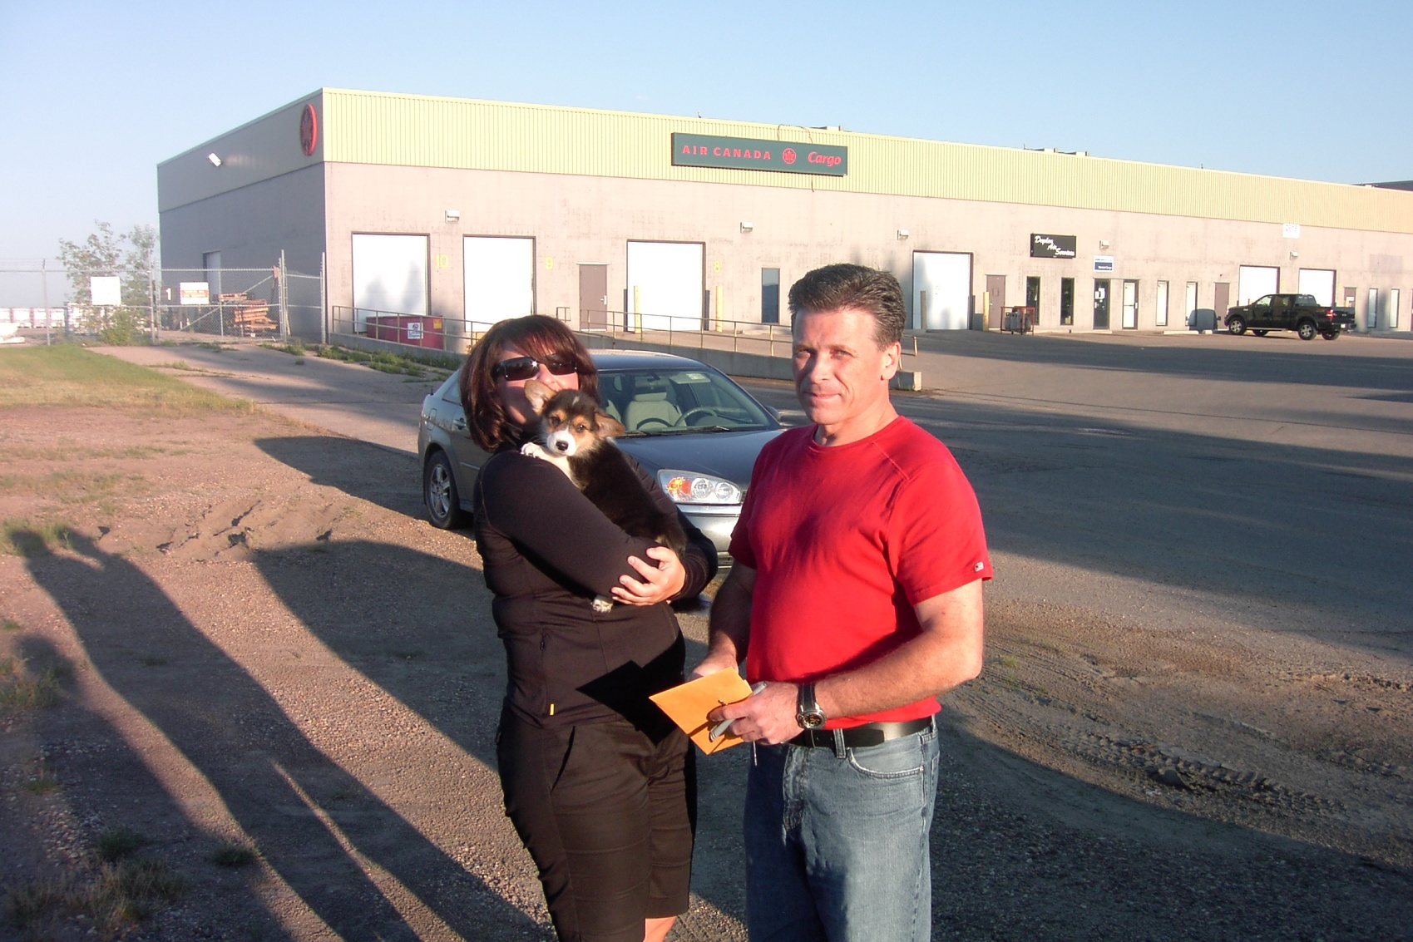
Frankie ( Happy ) is with her new family the Kindiak’s in Southern Saskatchewan

